Slide 1
Dr. Alessandra Candian & Dr. Lisanne Walma
Delft University of Technology
Open Educational Resources in Information Literacy

Slide 2
Overview
What is open education for us?
Case study 1: MOOC
Case study 2: TUlib
Final thoughts
Notes:
Michiel: OE is important for information specialists, you will all encounter it and should lead the change. Us: we will show how we apply OE in our information literacy material
Our courses
What is open education for us?
Availability, Shareability & Accessibility
Case study 1: MOOC
Using images in general (CC-BY license)
(good for accessibility, but copyright issues)
Audience very international, diverse
Recording & transcript
Accessibility
Funding
Community building & engagement
Case study 2: open by design: TULib
Open material, people can reuse
What is it, what is it not?
Challenges:
Using images, but also, keeping up to date
Sustainability: videos / links / have a platform that works for us within the strict boundaries of ICT
Wishes
Accessibility: images / texts / colors
Audiences with different levels of expertise
Final conclusion:
Experiences from MOOC taught us:
Variety with multimedia, great, but take more time to implement
Do it yourself
Make sure you can use it (ask the experts)
Experiences TULib:
Conclusion: working with open by design is great, but (have a good relationship with ICT ;) )

Slide 3
What is Open Education?
Freely Available
Reusable
Accessible
Notes:
What is open education? How can we achieve it? Open Education can be declined in many ways and in this presentation we will focus on the following aspect The delivery of teaching resources that is freely available, that can be reused and that is accessible to a larger audience.

Slide 4
Case Study 1: the Open Science MOOC
GOAL: Learn how to share your research effectively and in a responsible way
On EdX platform, 6 (3+3) modules, 1 module/week
On run per year (next May 18th), 95 enrolled international participants
Combination of text, multimedia, quizzes and assignments
IL keywords: information management, publishing, dissemination
Notes:
Next run May 18,

Slide 5
Case Study 1: the Open Science MOOC
a) Using images
To enrich educational material
To engage the audience
To beautify slides
TIME CONSUMING!
Low number of relevant images (abstract concepts)
Copyright issues: licences, unclear policies…
New image creation (software, designing skills…)
Notes:
Next run May 18,

Slide 6
Case Study 1: the Open Science MOOC
b) International audience
Diversify the educational material to make it relevant (eg. History of Open Science)
Recording videos with transcription/close caption (YouTube)
Scholarships to obtain the certified tracks
Notes:
Next run May 18,

Slide 7
Case Study 1: the Open Science MOOC
c) Community Building and Engagement
Engaging and relevant educational material
Fostering a safe environment in the discussion boards
Involvement of teachers in the board
Feedback videos on assignments
Ideas for the next run:
Live moments
Linking participants to local Open Science communities.
Open Life Science logo by Lucas Emanoell Medeiros e Silva
Notes:
Next run May 18,

Slide 8
Case Study 2: TUlib
GOAL: Information literacy guide for university students
Available to everyone through https://tulib.tudelft.nl/
Bachelor students / PhDs
Designed as CC-BY-SA, people can reuse
Notes:
Guide
Taking next steps to redesign

Slide 9
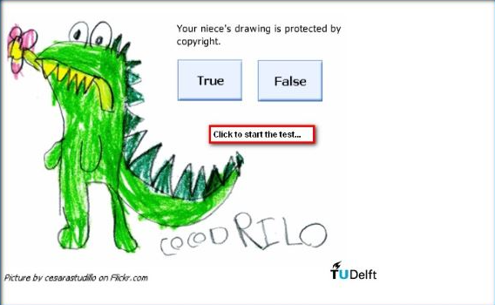
Case Study 2: TUlib Using Multimedia
Notes:
Reusability is really helpful!
Images, quizzes
Increase engagement and accessibility
Videos / links from other Open Educational Resources
Extra information
Detailed, good explanations
Wishes: increase accessibility, files, readers, colors
Add material for teachers

Slide 10
Case Study 2: TUlib Using Open Multimedia:
Copyright
Sustainability
Compatibility
Notes:
Challenge:
Copyright
Keeping up to date with OER from outside
Using open material: videos / links, new things to manage that can break down
Challenge
Integrate a OER with the current ICT infrastructure
Website functioning
Wishes: design for sustainability

Slide 11
Case Study 2: TUlib Diverse audience
Information Literacy 1
1st year BA
Information Literacy 2
Information Literacy 3
MA
Skills needed for MA thesis
Under development
Embedded in faculties
Basic skills
The Informed Researcher
PhD
Start of PhD research
Embedded in faculties
2/3rd year BA
Advanced
6 runs per year
Notes:
Great that you can use the material and put it in courses, very flexible, reusable
Course material
Reference work for PhDs, especially when searching

Slide 12
Case Study 2: TUlib Diverse audiences
TUlib
General
Structure
Bachelor / PhD courses:
Instructions
Context
Wishes:
Increase accessibility

Slide 13
Case Study 2: TUlib User Engagement
Notes:
Evaluations
Statistics
Email address
Main point: Really interesting to find out who is using your tool, their opinions, it circulates many locations!

Slide 14
Case Study 2: TUlib User Engagement
Wishes:
Feedback from users we know and potential new users
Find ways to engage with those we don’t know
Notes:
Standalone audience?
Teachers?
Wishes: Teacher engagement, clearer infrastructure, know who our users are

Slide 15
Final Thoughts

